Slide 2
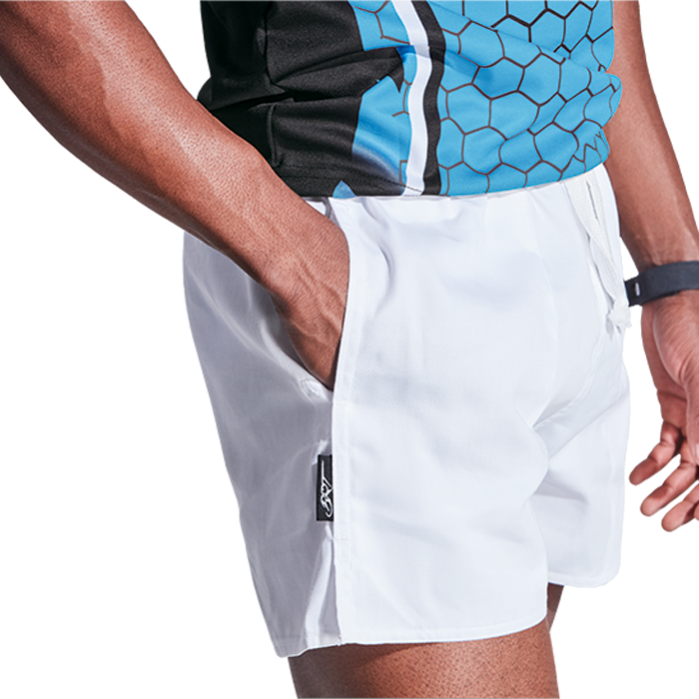
BRT Players Rugby Short
BRT Aero Running Shorts

Slide 3
BRT Motion Top
BRT Motion Skort

Slide 4
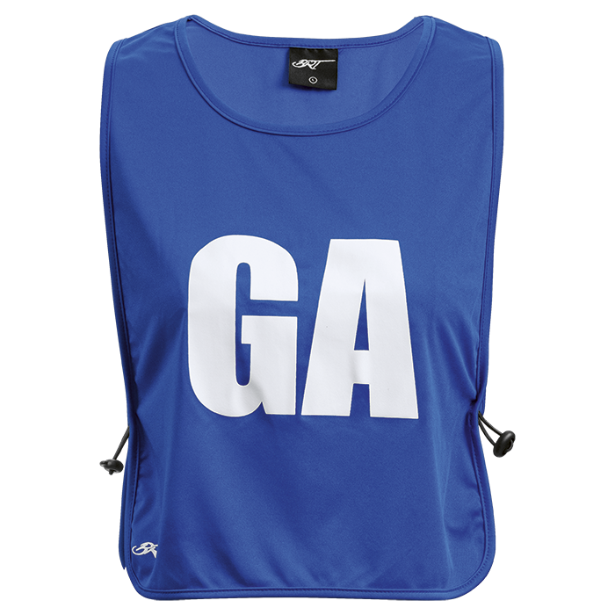
BRT Motion Dress
BRT Netball Players Bib Set Of 7

Slide 5
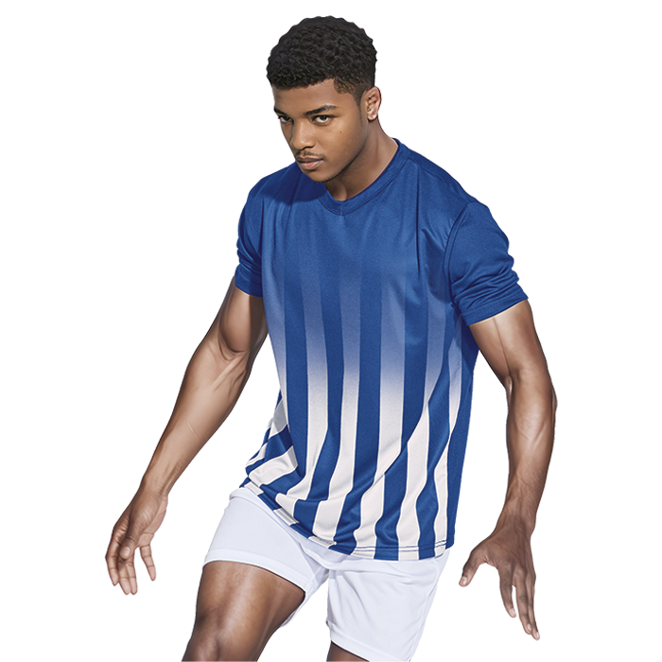
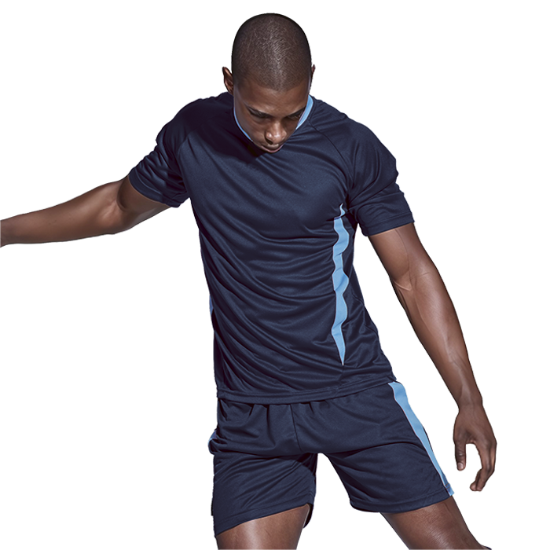
BRT Blade Soccer Single Set
BRT Match Shirt

Slide 6
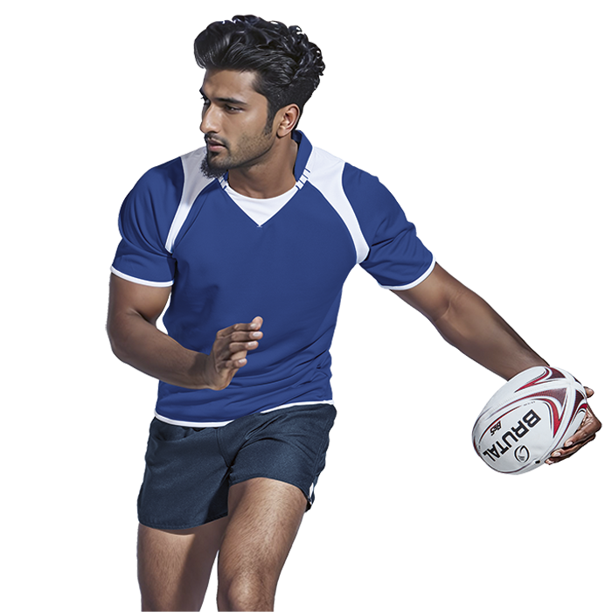
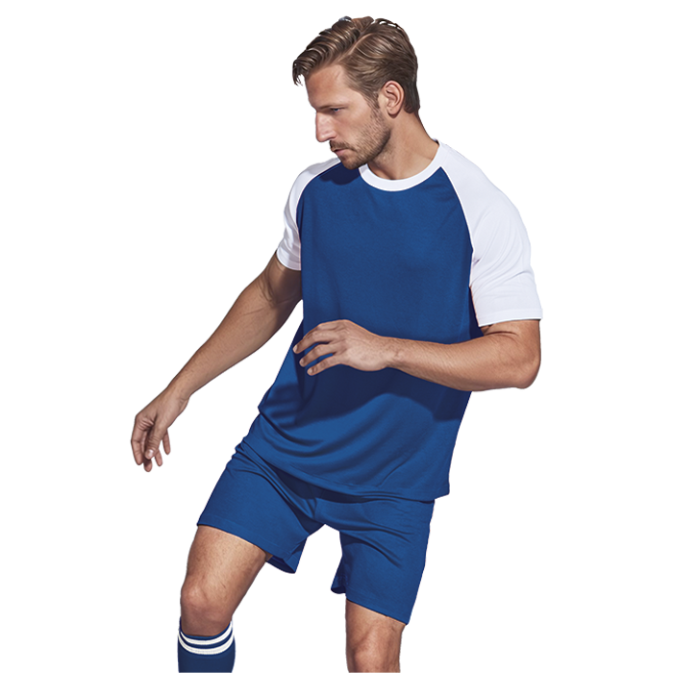
BRT Pakari Rugby Jersey II
BRT Pitch Soccer Single Set

Slide 7
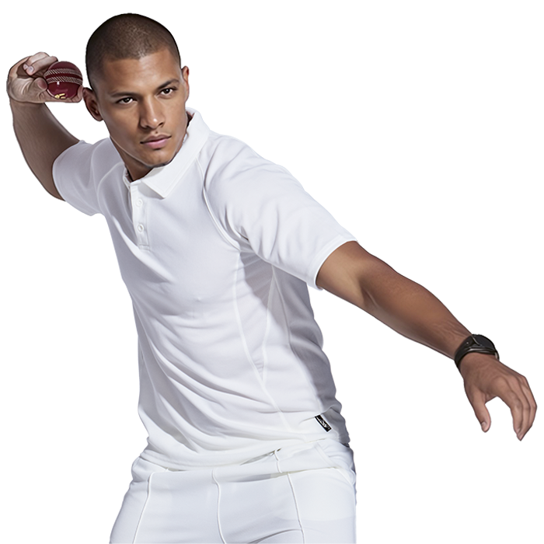
BRT Teamster Cricket Shirt
BRT Teamster Cricket Pants

Slide 8
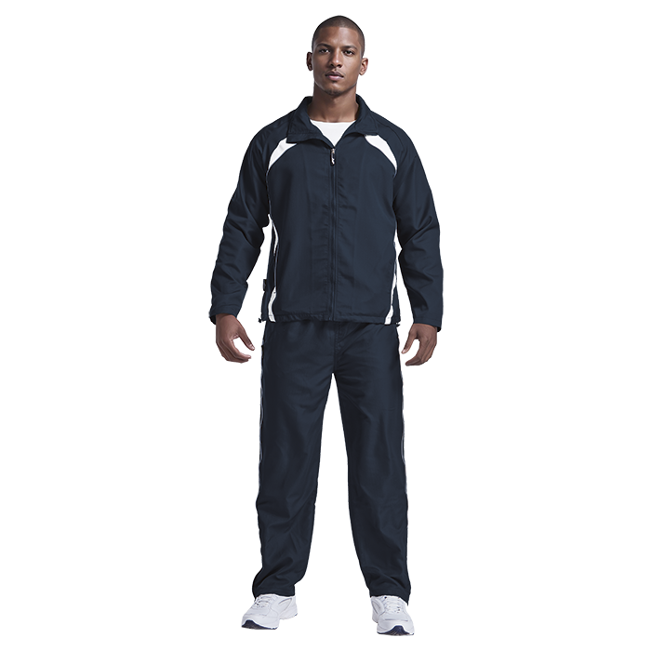
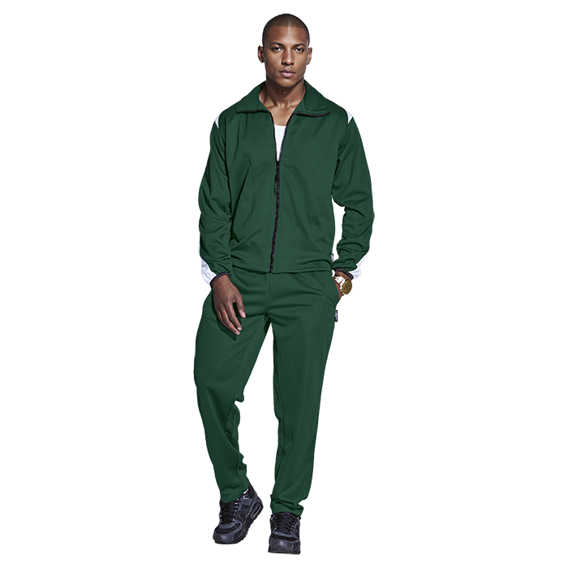
BRT Reflect Tracksuit
BRT Econo Tracksuit

Slide 9
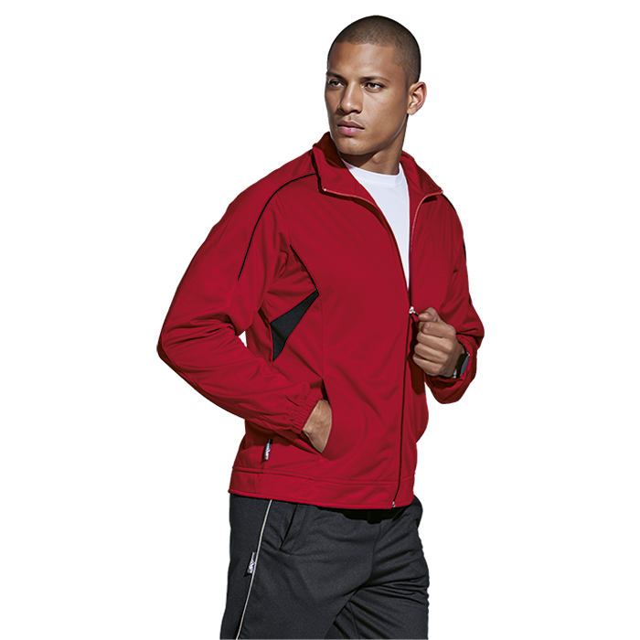
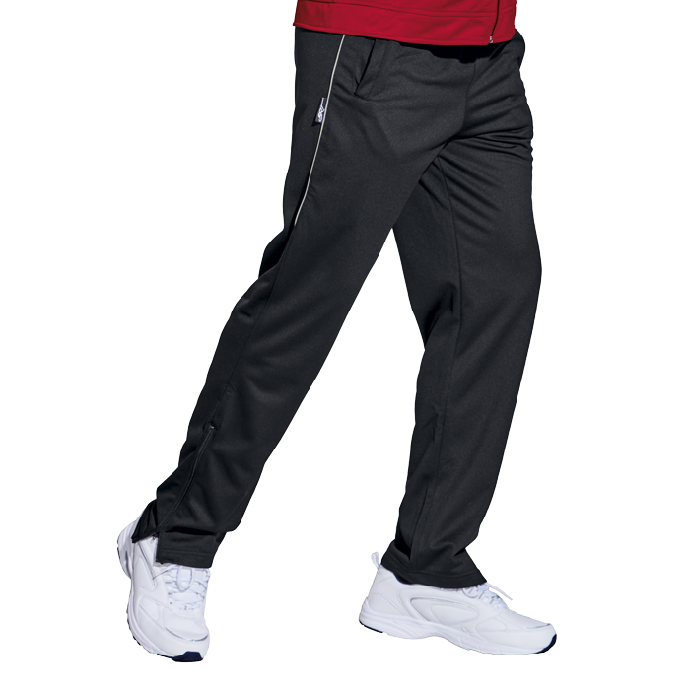
BRT Champion Tracksuit Top
BRT Champion Tracksuit Pants

Slide 10
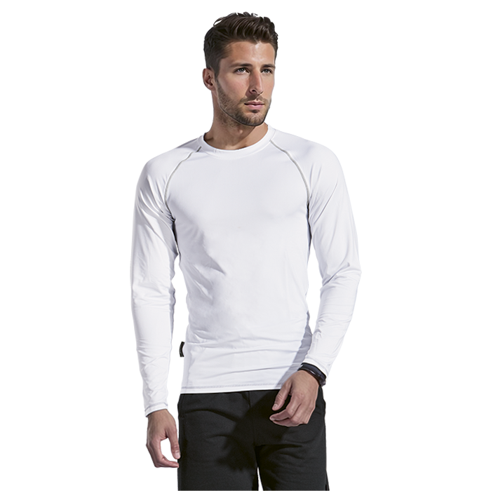
BRT Signature Long Sleeve Top Mens
BRT Signature Long Sleeve Top Ladies

Slide 11
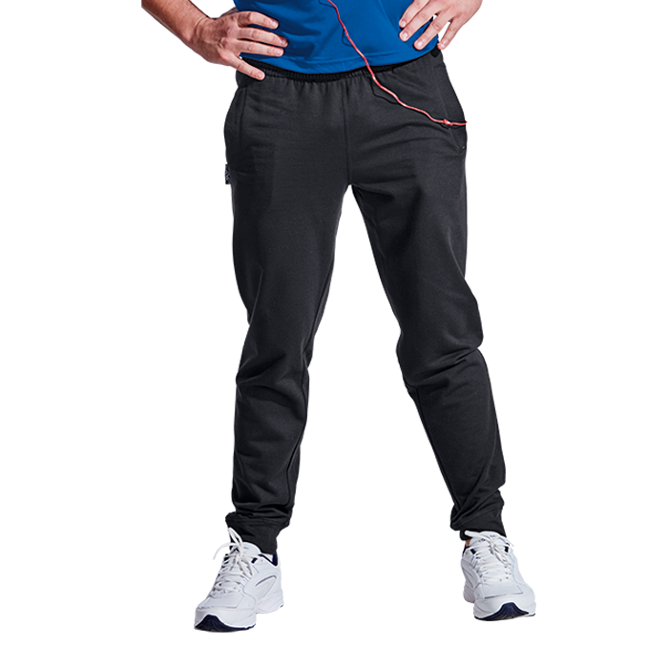
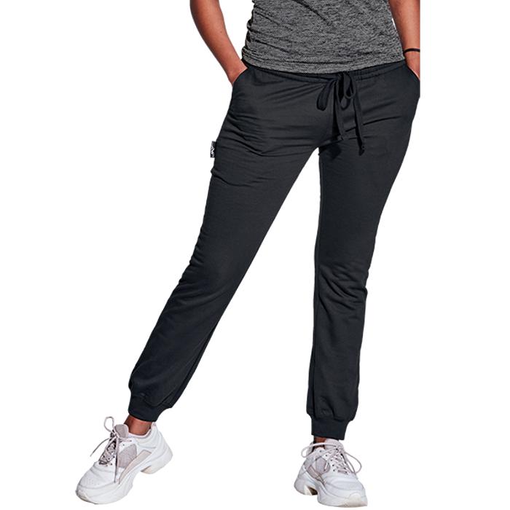
BRT Crossover Jogger Ladies
BRT Crossover Jogger Mens

Slide 12
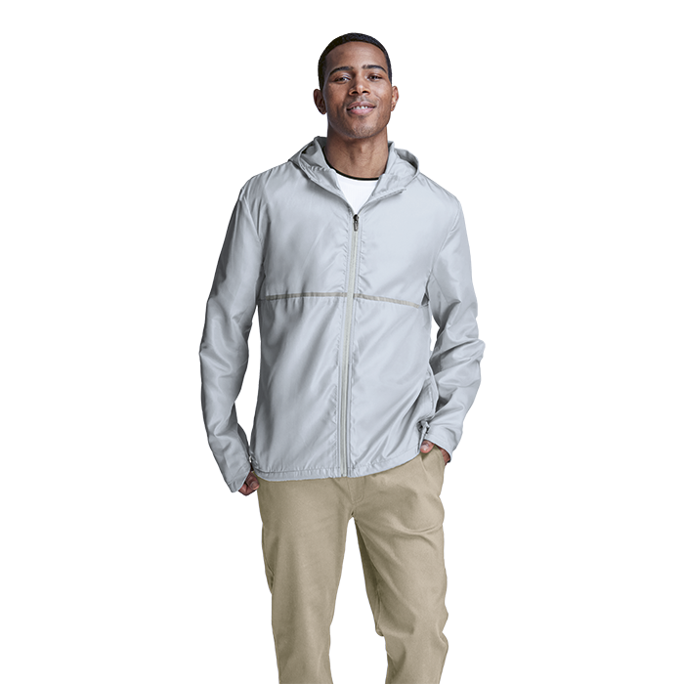
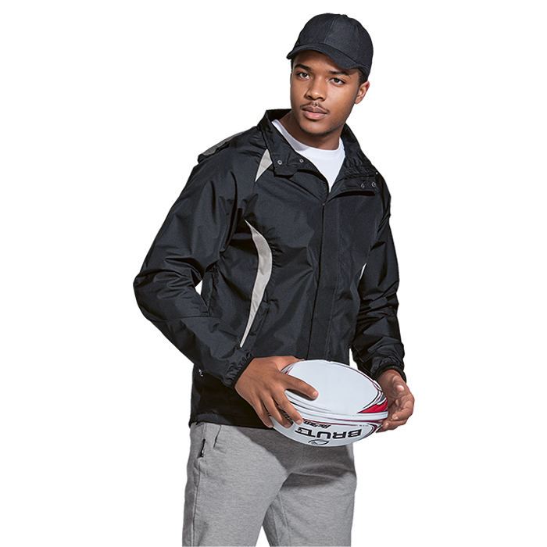
BRT Cool Dry Jacket
BRT Zone Jacket

Slide 13
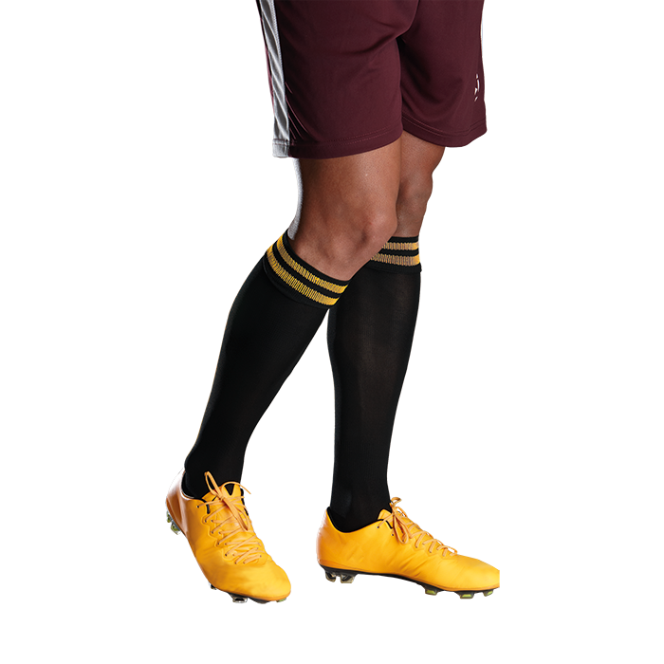
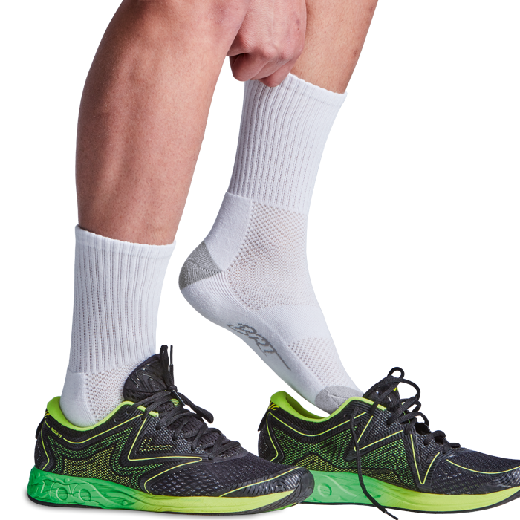
BRT Pace Sock
BRT Cast Sock

Slide 14
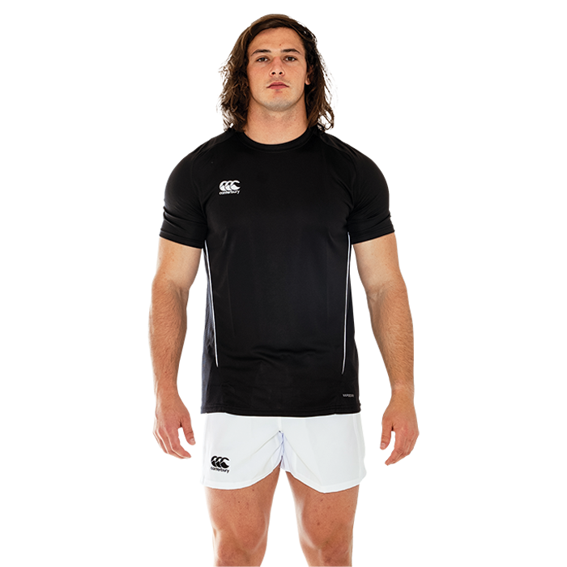
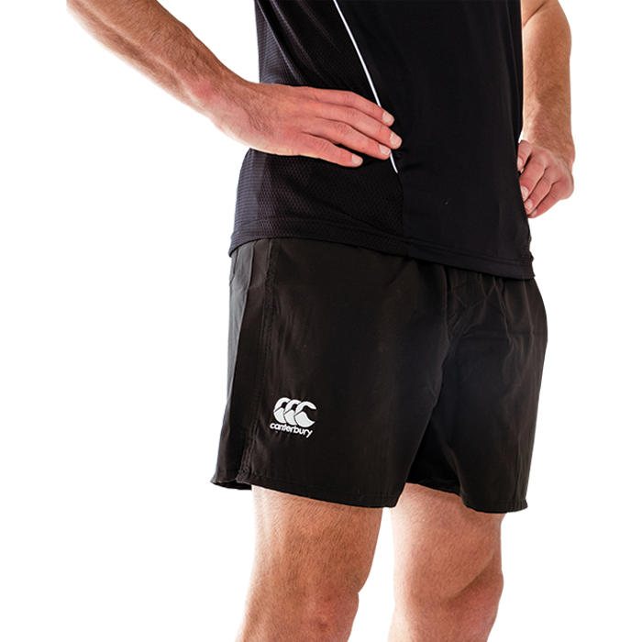
Canterbury Team Dry Tee Snr Mens
Canterbury Tactic Shorts

Slide 15
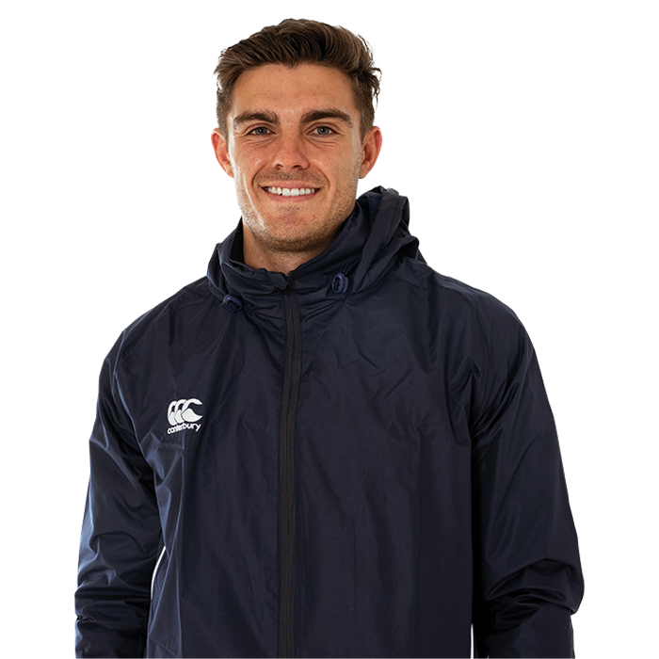
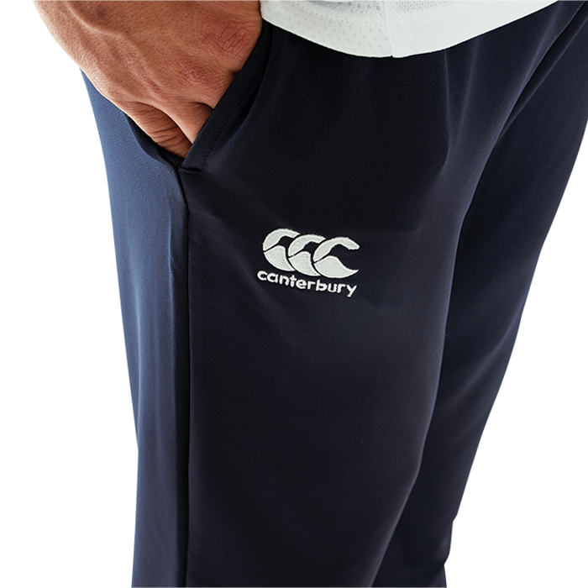
Canterbury Team Full Zip Rain Jacket
Canterbury Tapered Pants

Slide 16
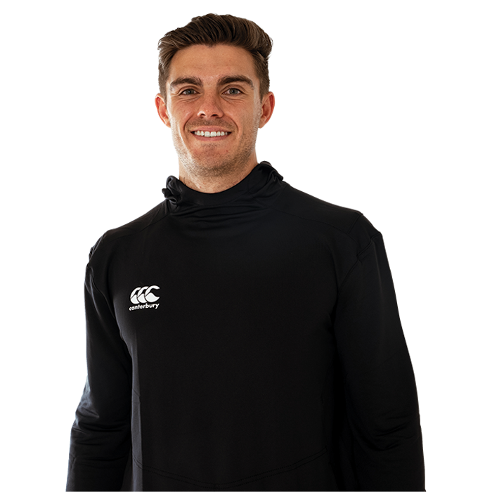
Canterbury Puffer Hybrid Jacket
Canterbury Pro Hoody

